Slide 1
Provost Report
Dr. Robert J. Marley
Provost and Executive Vice Chancellor for Academic Affairs
Faculty Senate Meeting June 16, 2016

Slide 2
Agenda
New Faculty Incentive Program Approved by President
Grad Student Funding Program Launched
Faculty Search Update
Chair Search Update
CEC Vice Provost and Dean Update
CIO Update
Final FY17 Budget Imminent

Slide 3
1. New Faculty Incentive Program Approved by President
http://provost.mst.edu/facultyincentiveplan/
Task Force Members:
Daryl Beetner, Chair (ECE)
Suzanna Long (EMSE)
James Drallmeier (MAE)
Stephen Clark (Math & Stat)
Jagannathan Sarangapani (ECE)
Yinfa Ma (Chemistry)
Philip Whitefield (Chemistry)
Mary Jo Richards, Ex-Officio (Fiscal)
Ryan Rapp, Ex-Officio (UM System)
Eric Vogelweid, Ex-Officio (UM System)

Slide 4
2. Grad Student Funding Program Launched
Committee Members:
Robert Landers, Chair (MAE)
Daryl Beetner (ECE)
Joel Burken (CArE)
Mariesa Crow (ECE)
Richard Dawes (Chemistry)
Bill Fahrenholtz (MSE)
Greg Hilmas (MSE)
Matt Insall (Math & Stat)
Walt Branson, Ex-Officio (Finance)
Rose Horton, Ex-Officio (Strategic Planning)

Slide 5
3. Faculty Search Update
33 searches approved this AY
17 acceptances; 9 in negotiation; 3 interviewing; 3 still active; 1 initiated but active next AY

Slide 6
4. Chair Search Update
CArE—in negotiation
Mining/Nuclear—in negotiation
Biological Sciences—in negotiation
GGPE—initiated
EMSE—authorized for AY17

Slide 7
5. CEC Vice Provost and Dean Update

Slide 8
6. CIO Update

Slide 9
7. Final FY17 Budget Imminent
Advance peek provided to Senate officers

Slide 10
Division Updates

Slide 11
College of Arts, Sciences, and Business
Daniel Fischer (Physics) has been awarded a CAREER awards totaling $400,000 by the NSF for his project entitled “Control and Analysis of Atomic Few-Body Dynamics.”
V.A. Samaranayake (Mathematics and Statistics) has received funds totaling $230,311 from Missouri Department of Higher Education for his project entitled “Science Education and Quantitative Literacy: An Inquiry-Based Approach.”
Honglan Shi (Chemistry) has received funds totaling $50,000 from PerkinElmer Health Sciences, Inc. for her project entitled “Beta Testing of PerkinElmer’s ICP-OES (Inductively Coupled Plasma-Optical Emission Spectroscopy) Instrument.”
Ulrich Jentschura (Physics) has received an additional
$75,000 from NSF for his project entitled “Quantum
Vacuum and Atoms” bringing the total grant amount
to $225,000.

Slide 12
College of Arts, Sciences, and Business
UM Research Board Funding
Julie Semon (Biological Sciences) received $51,463 for her project entitled, “Bioactive Glass and Adipose Stem Cells in Wound Healing.”
Chen Hou (Biological Sciences) received $51,463 for his project entitled, “Oxidative Damage is More Sensitive to Growth than to Metabolism.”
Kathryn Dolan (English and Technical Communication) received $10,000 for her project entitled, “Dinner Stories: Food Animals and the Environment in the Nineteenth-Century U.S. Literature.”
Aleksandr Chernatynskiy (Physics) received $28,000
for his project entitled, “Spin Crossover and Thermal Conductivity of Fe-Mg-O.”

Slide 13
College of Arts, Sciences, and Business
Best-in-Class Pilot Study Program
Matthew Thimgan (Biological Sciences) received $20,000 for his proposal, “Objective Detection of Sleepiness Using Physiologic Measures.”
Manashi Nath (Chemistry) received $20,000 for her proposal, “Synthesis of Robust Nanostructured Borides and Carbides for Smart Applications under Extreme Environments.”
Student Recognition
YeonKyung Lee (English and Technical Communication) was awarded $3,711 by the C.R. Anderson Research Fund Board of the Association for Business Communication for her research comparing the social media content of U.S. and Korean consumer products and airline companies and compiling indicators of effectiveness related to cultural context. She also received an internship with Southwest Airlines based on this work.

Slide 14
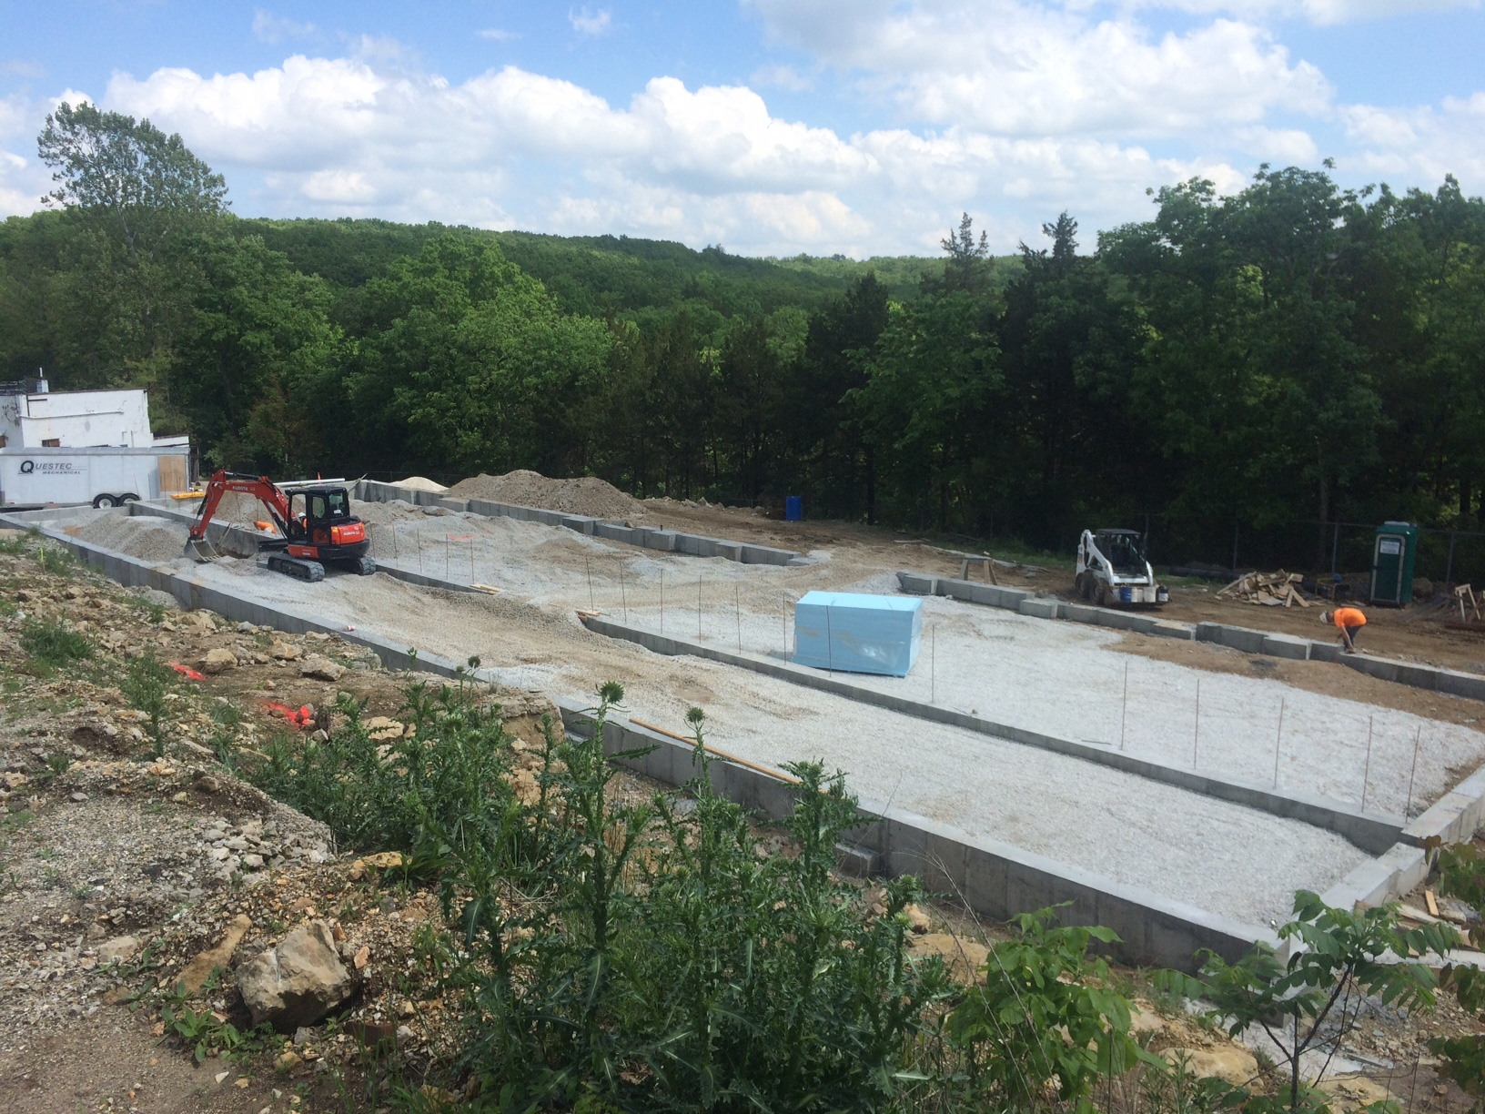
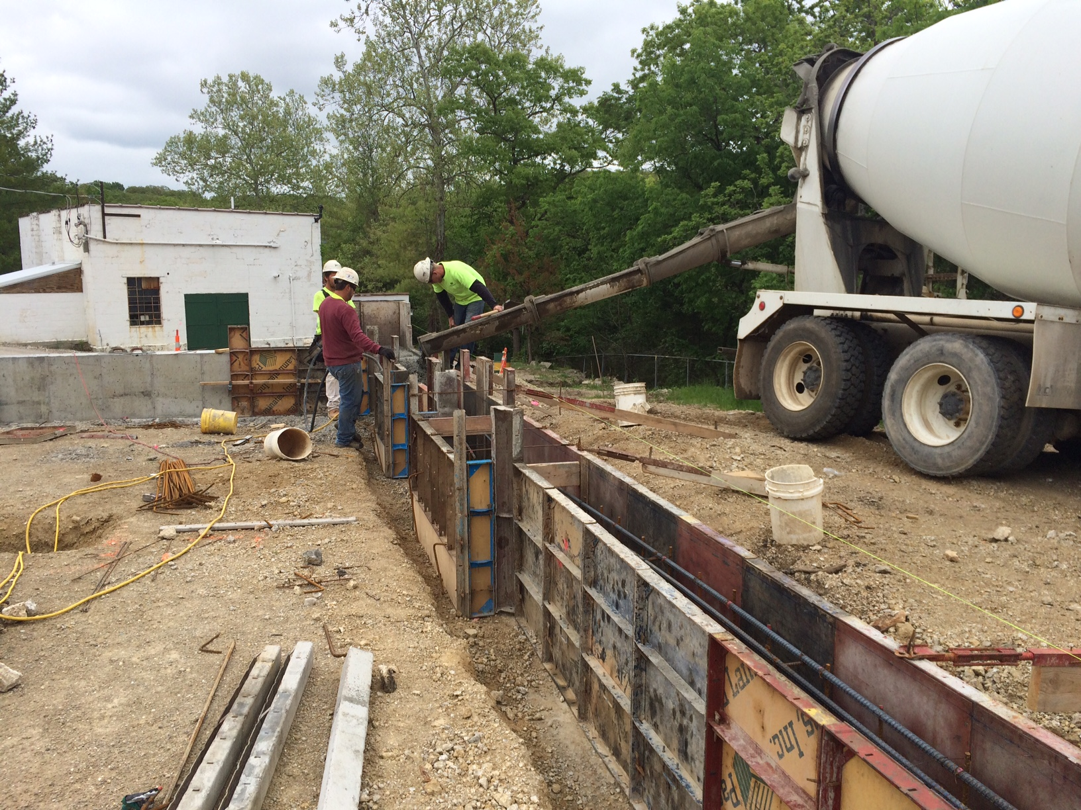
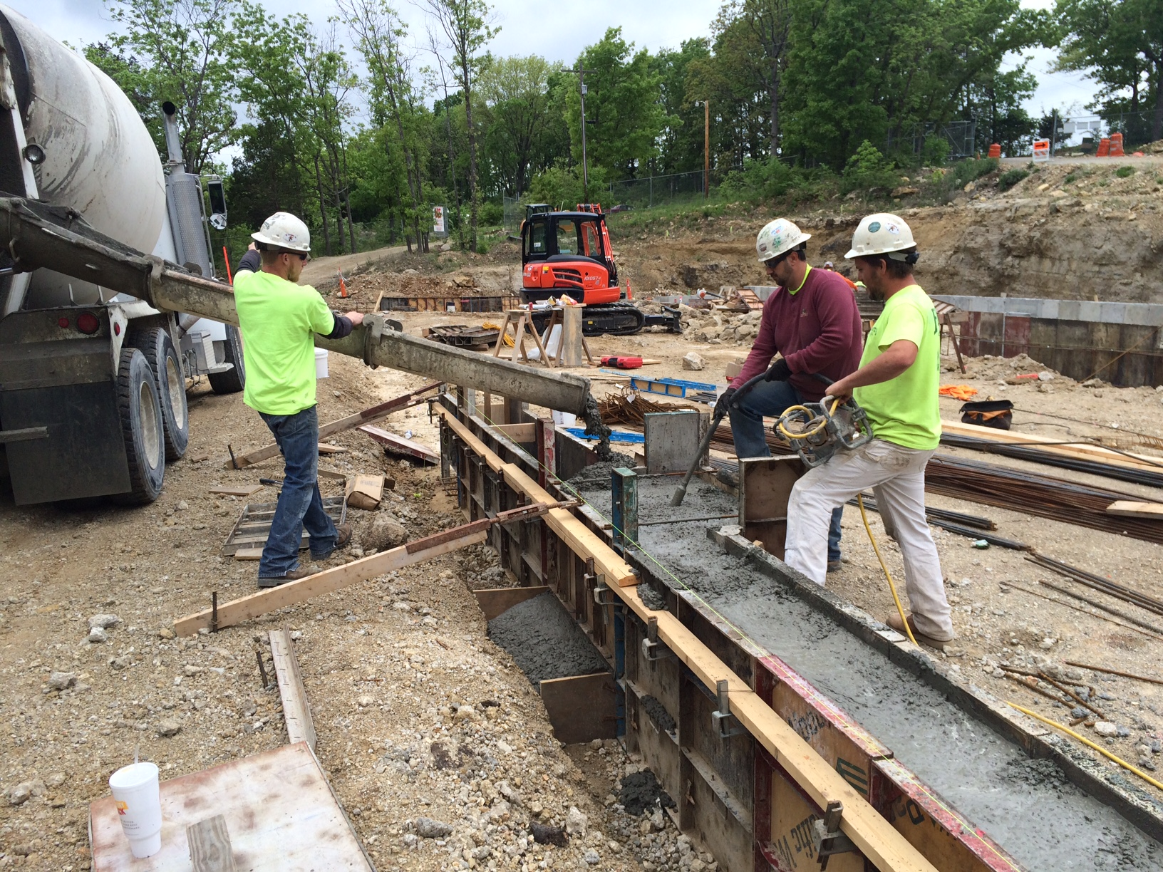
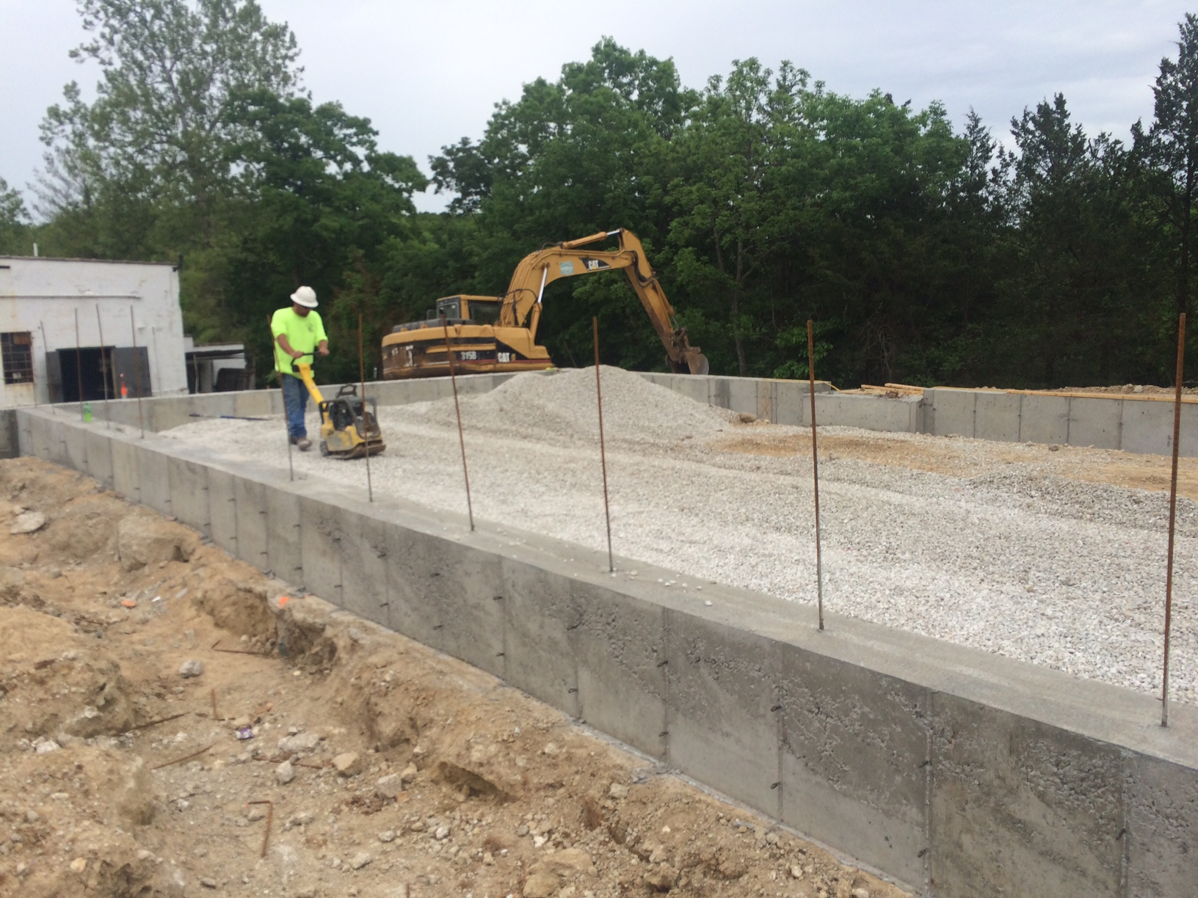
College of Engineering and Computing
Dr. David J. Rogers (GGPE) selected as Fellow in the American Society of Civil Engineers (ASCE).
Dr. Curt Elmore (GGPE) selected as Fellow in the American Society of Civil Engineers’ Environmental and Water Resources Institute (ASCE-EWRI).
Dr. Simon Lekakh (MET) earned an Award of Scientific Merit from the American Foundry Society.
Dr. Steve Watkins (ECE) profiled in the March-April 2016 issue of ASEE Prism for his work as ASEE Zone III chair.
Dr. William Schonberg (CArEE) presented at TEDxUCCI 2016 at the University College of the Cayman Islands. Schonberg stressed that everyone needs to be technically literate to compete in the world of tomorrow.
Experimental Mine Progress Pictures

Slide 15
Office of Undergraduate Studies
Student Design and Experiential Learning Center Competitions
Mars Rover, Mars Desert Research Station-Hanksville Utah, June2-4
Formula SAE, Barrie Molson Center, Barrie Ontario, June 2-5
Robotics, Oakland University, Rochester Michigan, June 3-6
Advanced Aero Vehicle Group-Rocket, Green River Utah, June 15-18
Hit the Ground Running (HGR) – July 10-19, 2016
Summer Bridge Program
55 Registered
Goal Enrollment is 100
Service Learning Symposium – October 11, 2016
Opportunities for Undergraduate Research Experience
FS2016 – SP2017, 180+ Students accepted

Slide 16
Office of Graduate Studies
Graduate Certificates
Graduate Studies and Office of the Registrar working together to streamline Graduate Certificates in Course Leaf.
Would allow for the automation of the certificate process and approval process
Thesis/Dissertation Format Checks
106 format checks completed for Spring 2016
Graduate applications for admission
1596 applications processed since January 1, 2016
926 admitted
670 denied
Office of Graduate Studies has moved (partially) for the summer to 307 Norwood during construction.
Advising is still located in G8 Norwood through
construction.

Slide 17
Enrollment Management
Early registration for Fall 2016 is up 4.3% however the decline in new graduate students will bring the total enrollment increase to around 2.0% or a little over 9,000.
Freshmen class is projected at 1,508 or a 1.3% increase.
Freshmen will continue to have high academic credentials and an increase is anticipated in females and minorities. The percentage of students in engineering is declining.
New transfers will be flat while graduate students will decrease.

Slide 18
Office of Sponsored Programs
Summary of FY16 activities year-to-date (March)
Number of funded proposals up 25% for a total of 221
Total dollars is $24M which is down 6%
Number of new proposals submitted is down 2% at 431
Total dollars is $124M which is down 14%
Number of active awards is up by 4% at 598
Total expenditures is $29M which is down 5%
Net grant and contract expenditures is $21.4 M which is down 9%
F&A recovered is $3.7M which is down 17%

Slide 19
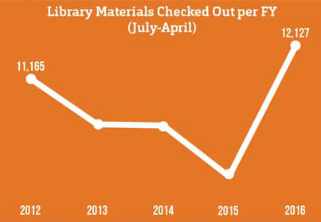
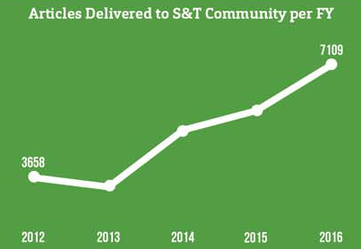
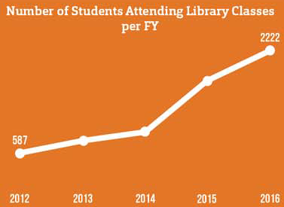
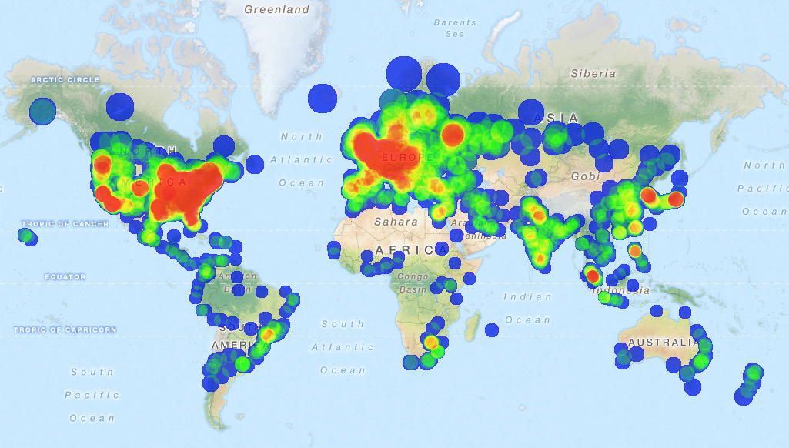
Curtis Laws Wilson Library
Statistical Sampler
Robust Growth of Library Services in FY16
Heat map of visits to Scholars’ Mine (2015: 203,526 page views)

